Slide 1


Slide 2


Slide 3
Delph INS Subsea
Robert goldschmeding
09/2025

Slide 4



Slide 5

Exail at a glance
2000+
EMPLOYEES
450+
MILLIONS EUROS
OF TURNOVER
20%
OF TURNOVER
INVESTED IN R&D
80%
of turnover generated abroad
Notes:
EMPLOYEES December 2024
Turn over 2023

Slide 6

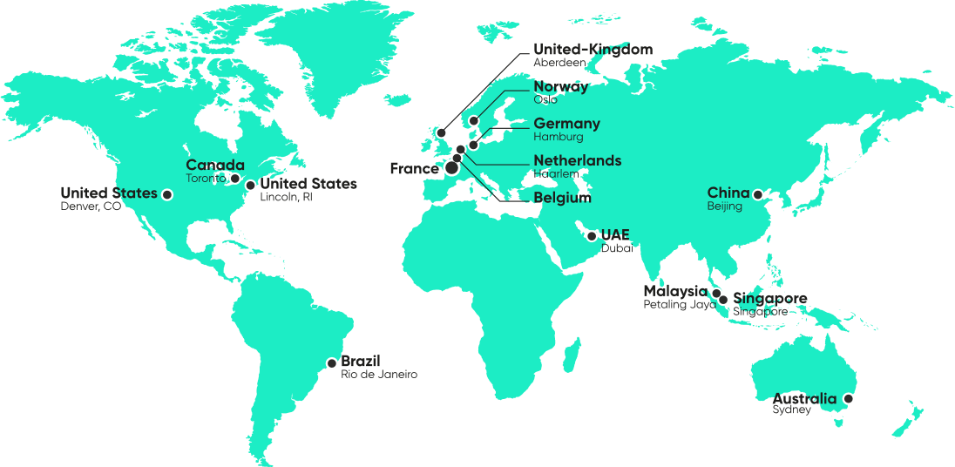
A global footprint
24/7 SUPPORT

Slide 7


A unique technological know-how
21 INDUSTRIAL
SITES
2 JOINT RESEARCH LABORATORIES

Slide 8
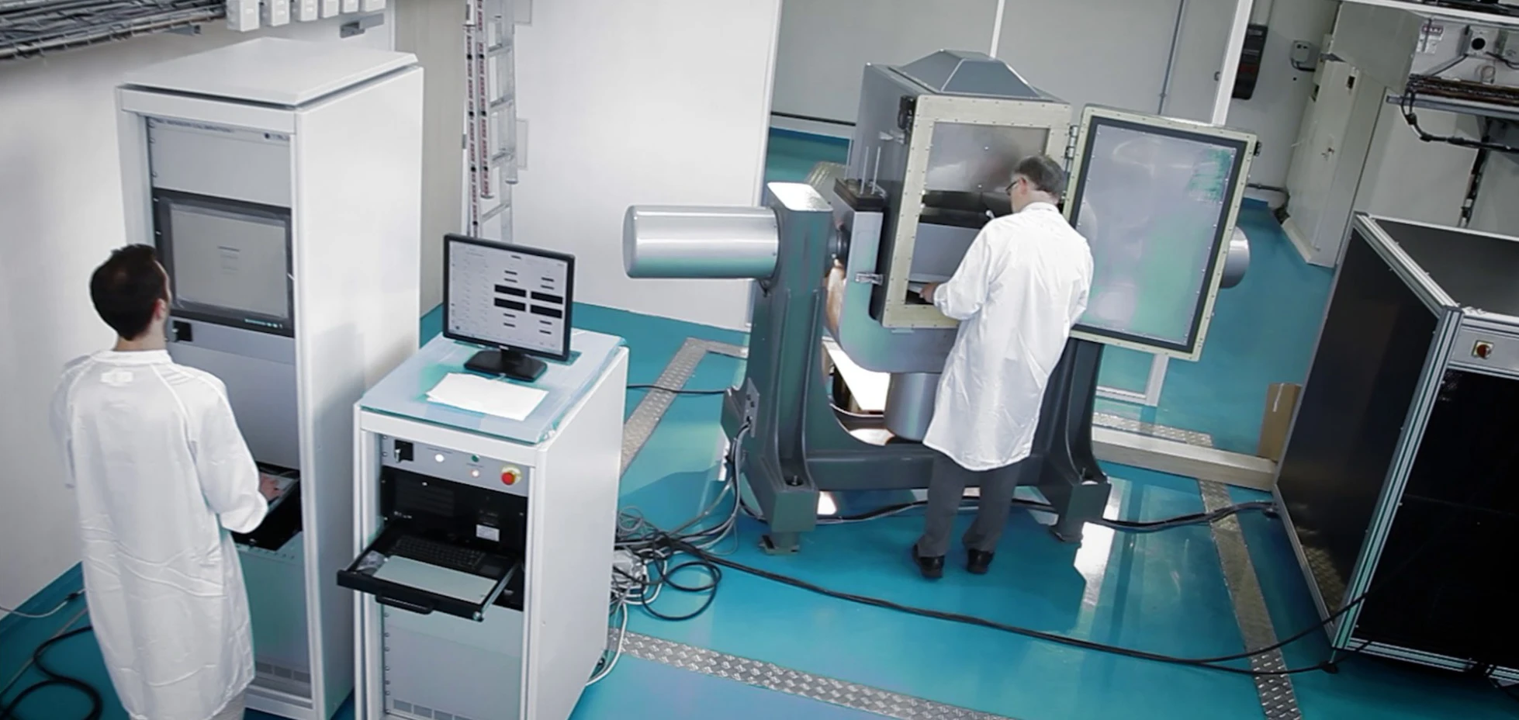

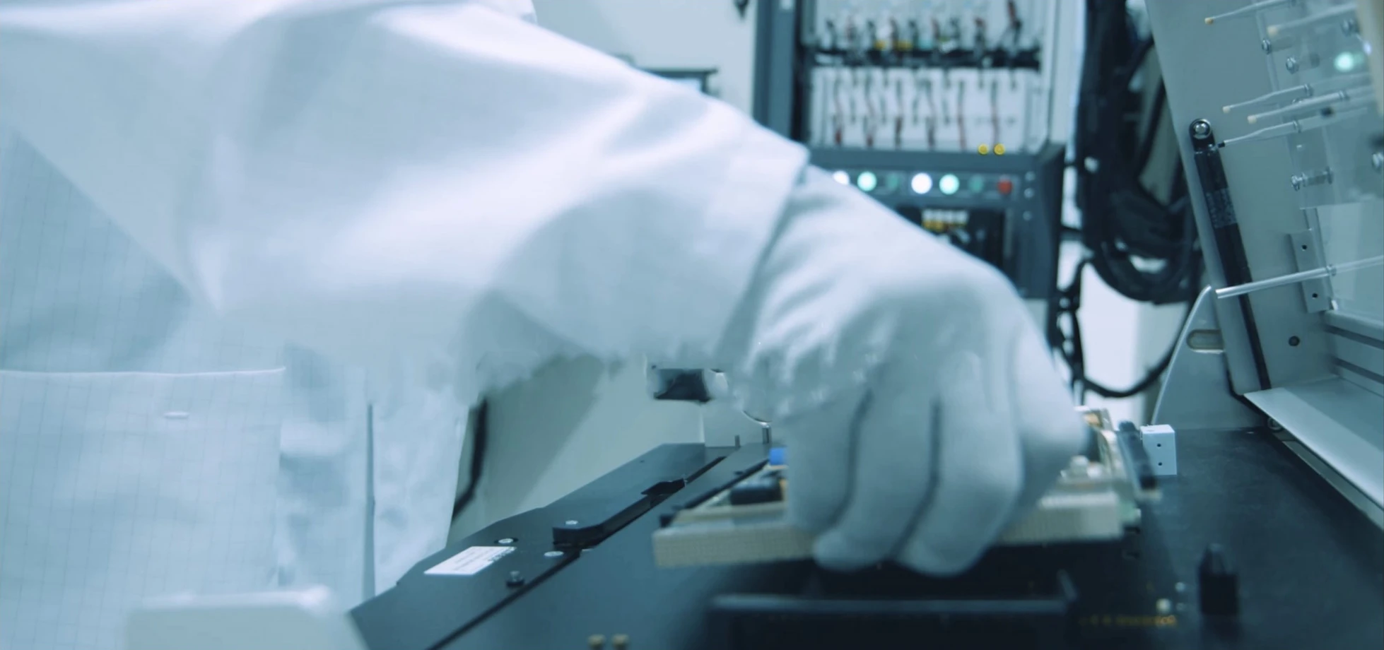

Cutting-edge industrial capacities
Within our 21 industrial facilities, we benefit from cutting-edge infrastructures and very high production capacities.
Our teams are made of highly skilled operators and technicians and we constantly adapt our processes
to ensure the highest productivity, efficiency, and quality.
All our components, products, and solutions
are manufactured and continuously improved
in compliance with regulations and quality.

Slide 9

Our organisation

Slide 10




Our expertise

Slide 11
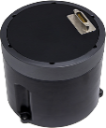
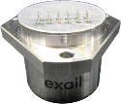
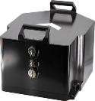
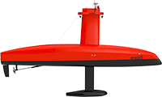



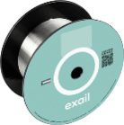

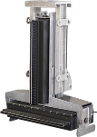



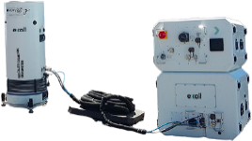

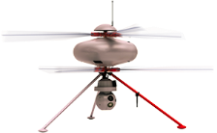
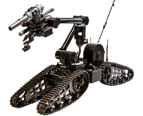
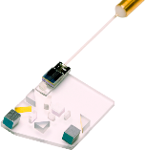
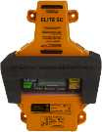
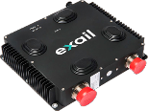
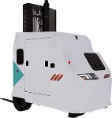
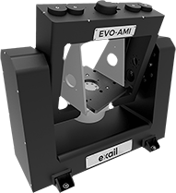
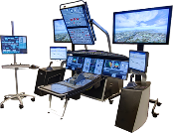
From components to complex systems
Components
Equipment
Platforms
Complex systems
Optic
Inertial navigation
Surface drones
Autonomous DRONES
CONTROL & COMMAND SYSTEM
Sonars & positioning
Underwater drones
Quantum instruments
Unmanned ground
& aerial vehicles
On-board electronic
Simulators

Slide 12




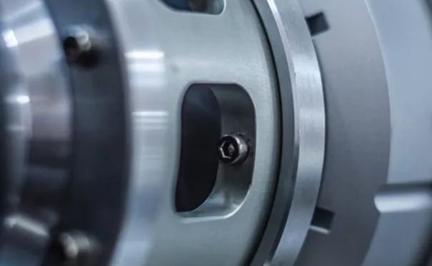
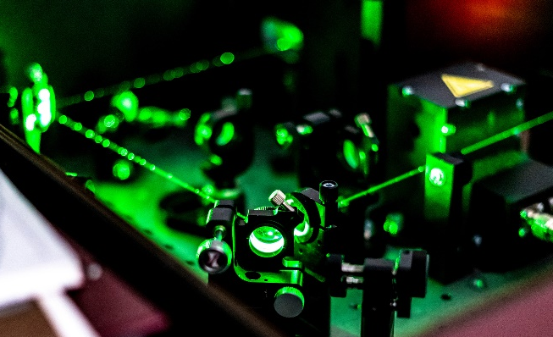

Main applications
Defense
& Security
  Naval & land navigation
  Ship equipment
  & protection
  Mine countermeasures (MCM)
  Maritime Domain Awareness (MDA)
  Homeland security
  & land forces
  Training simulation
Maritime
Energy & renewables
Hydrography &
oceanography
Geoscience
Fishery
Space
Navigation
Communications
Stratospheric balloons
Aeronautics
Maintenance tools
(MGSE & EGSE)
Test means
Assembly lines
Onboard services
Training simulation
Industry
& Logistics
Rail
Tunneling
Material processing
Mobile mapping
Nuclear
Sensing
Autonomous vehicles
Research labs
Quantum
Earth monitoring
Ocean science
Laser facilities
Photonics experiments

Slide 13
Delph ins advanced subsea

Slide 14
Introduction

Slide 15
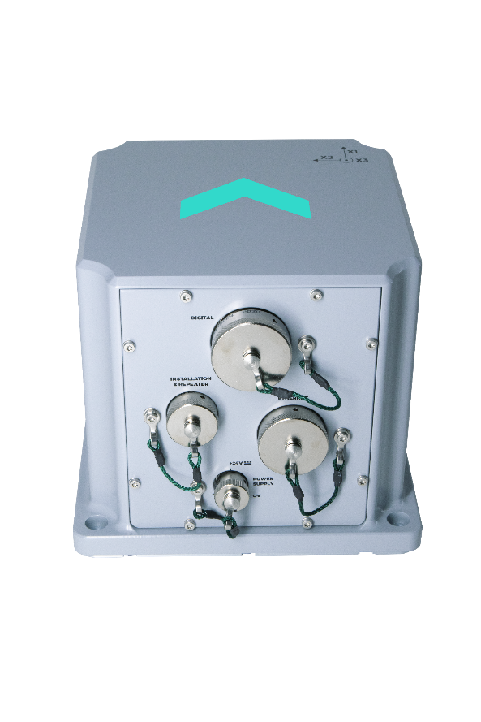
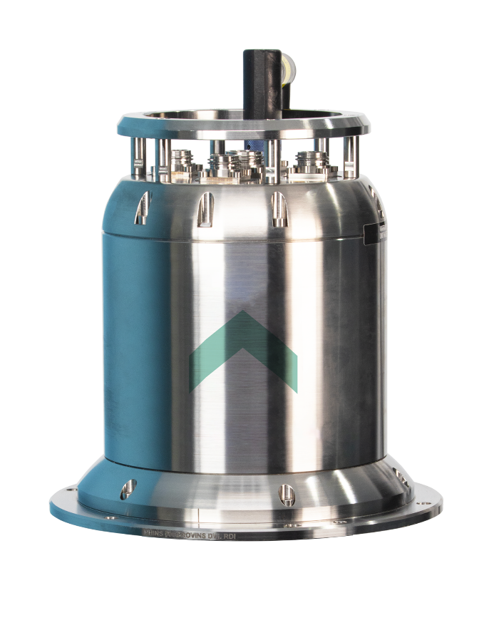
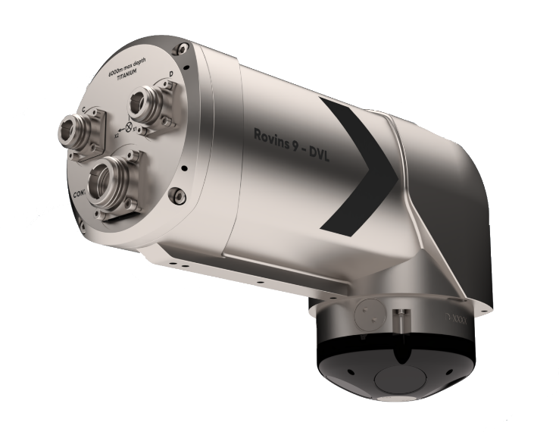
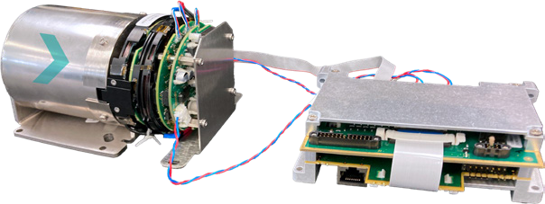
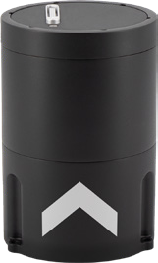
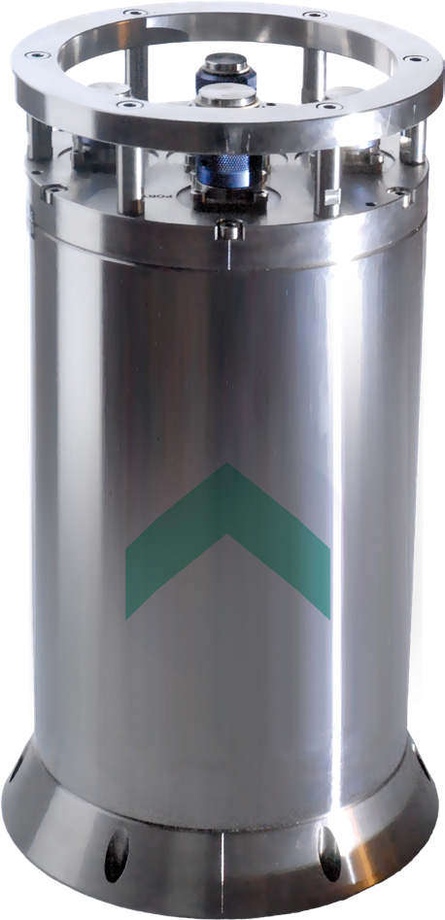
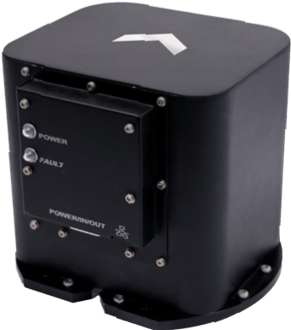
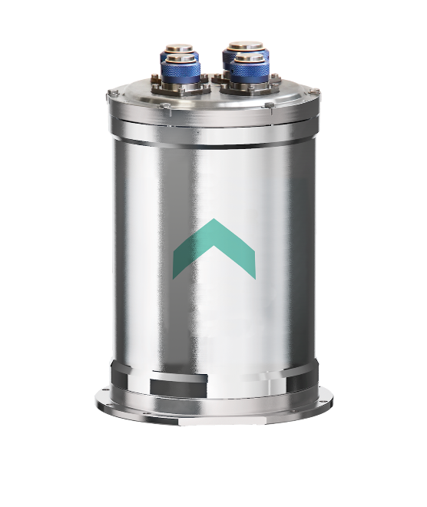
Purpose of the software
Delph INS Subsea is a processing data solution helping you to get the best from your Exail INS based inertial navigation system.
Allow you to post-process your data with custom INS settings.
Integrate data from external sensors that could not be connected to the INS during the survey.
Enhance the quality of the data using our optimized algorithm.
Help you to evaluate different positioning scenarios.
DELPH INS Subsea can process data acquired with any Exail INS but focuses on subsea applications:

Slide 16
DELPH INS Advanced Subsea features
Processing
Alignment in motion (with speed sensor)
Correct depth from atmospheric pressure
Change standard deviation of aiding sensors on a time basis
Compute depth from raw pressure measurement
Reduced processing duration
Data analysis
Store intermediate forward and backward results
Compare two trajectories with the trajectory separation tool
Load previous processing results in the project
Compute statistics on data
Interoperability
Human readable project file format
Improved user defined export tool

Slide 17
Logging requirements are unusual
Inertial navigation is based on the integration of small successive measurements. If a part of the measurements is missing the integration can’t be done.
The whole survey must be recorded not only the lines of interest
Data can be split into multiple files over time but need to be reassembled before being processed using DELPH INS
An INS must be still during 5 minutes after being turned on (or receive speed from a speed sensor) and then turns must be done to help the system to observe internal bias before switching in the navigation mode
The alignment phase of the survey must be logged because the post-processing algorithm will need to replay the sequence

Slide 18
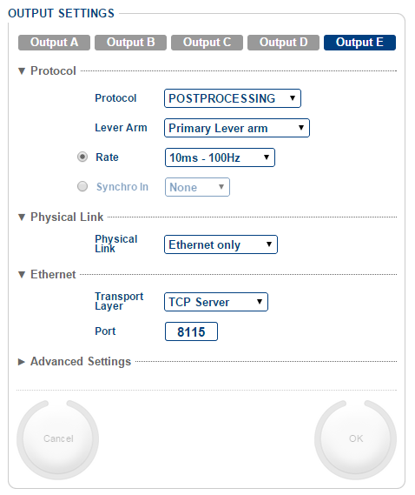


Logging of the POSTPROCESSING stream from INS
Configure output of the POSTPROCESSING protocol at 50Hz, 100Hz or 200Hz using a TCP/IP link (recommended) or a serial link.
Log the data using the embedded data logger of the INS web MMI or a third-party data logger.
The data rate is about 21 Mb per hour @ 100 Hz.
Depending on the INS type the unit may be internal or external
A minimum of 20 minutes of data is recommended for a proper decoding of the data
Notes:
The INS needs approximatively 400 seconds recording to transmit the whole configuration. The recording must then be of a length greater than 2 x 400 s to ensure that a whole configuration is present in the dataset.
800 sec = 13.333 min

Slide 19
Basic INS
Click to skip

Slide 20
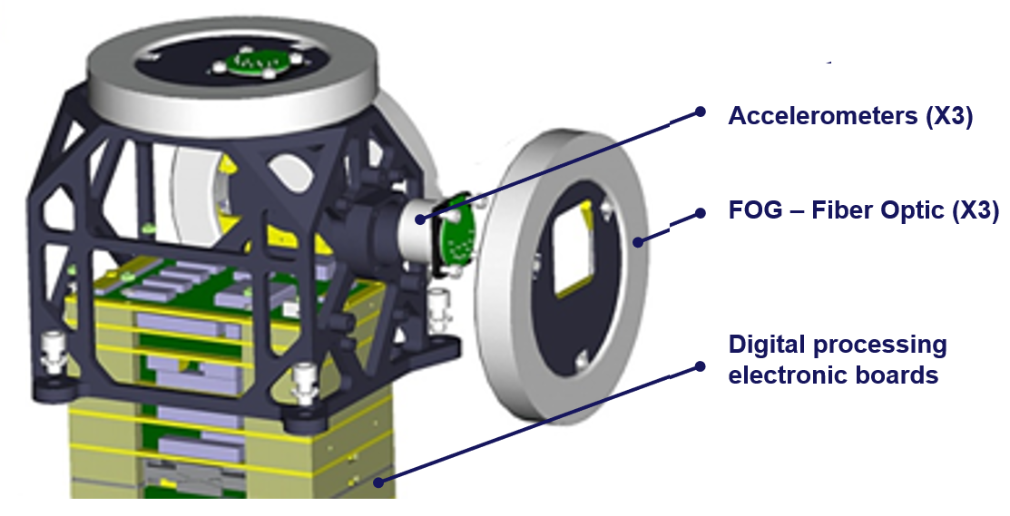
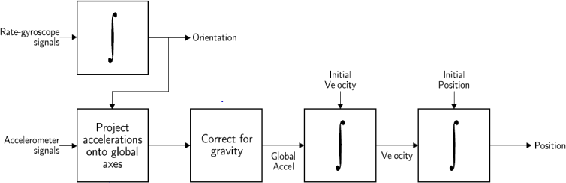
INS – Inertial Navigation System
Linear accelerations measured by 3 accelerometers
Rates of rotation measured by 3 gyroscopes
Takes all available aiding sensors (DVL, USBL, LBL, GNSS…)
Heading, Roll and Pitch

Slide 21

Sagnac effect
FOG (Fiber Optic Gyroscope) is used to measure a rotation
FOG are using Sagnac effect
Laser source
Ω
Detector
Δϕ = f( )

Slide 22
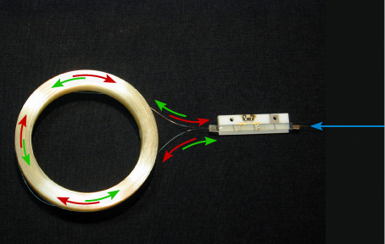
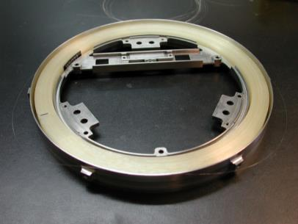
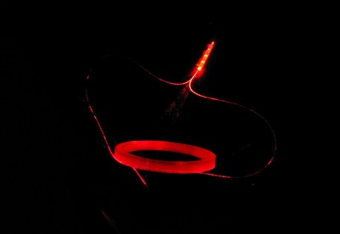
FOG technology
Integrated Optical Circuit Polariser + Divider + Modulator
Spool of optical fibre
Optical
Coupler
IOC
Optical
Optical
source
Fiber
Coil
Optical detector
NO ROTATION
Digital Signal
Processing
Modulation
Module
« All-Digital »
Processing
Function
Detection Module
Integrated Optical Circuit
Polariser
+
Divider
+
Modulator
Spool of optical fibre

Slide 23
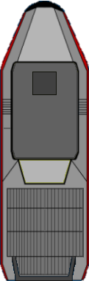
FOG technology
Integrated Optical Circuit Polariser + Divider + Modulator
Spool of optical fibre
Optical
Coupler
IOC
Optical
Optical
source
Fiber
Coil
Optical detector
ROTATION
Digital Signal
Processing
Modulation
Module
Detection Module
« All-Digital »
Processing
Function
FOG can be open or closed loop design : high performance = closed loop

Slide 24
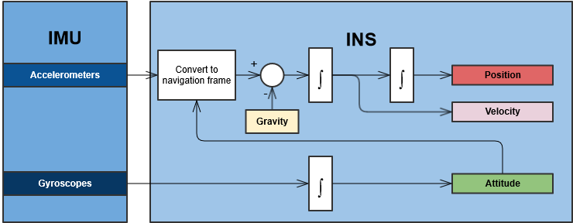
INS – Inertial Navigation System
IMU Inertial Measurement Unit
INS Inertial Navigation System

Slide 25
Kalman filter

Slide 26

Kalman filter
Definition
  “A mathematical method (1960-61)* named after Rudolf E. Kalman. Its purpose is to use measurements that are observed over time that contain noise (random variations) and other inaccuracies, and produce values that tend to be closer to the true values of the measurements and their associated calculated values.”
By Greuel, Gert-Martin - https://opc.mfo.de/detail?photo_id=11513, CC BY-SA 2.0 de, https://commons.wikimedia.org/w/index.php?curid=18069950

Slide 27
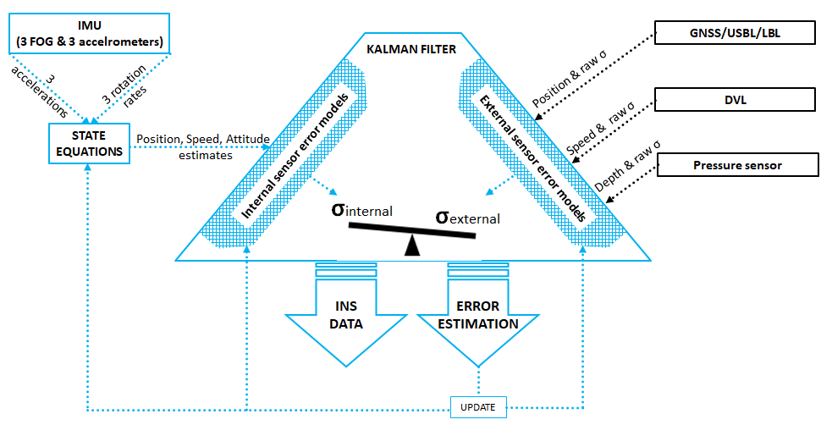
Kalman filter features

Slide 28
Kalman Filter: the steps
The Kalman Filter typically estimates:
  Attitude errors
  Position error
  Speed error
  Internal sensor errors (FOG and accelerometer biases, scale factors, etc.)
These errors propagate with time and are related
External observations must be accurate. If they are not, the Kalman Filter may be corrupted
This means that both the configuration of the external sensor (lever arms, timestamping) and its error estimation (standard deviation provided by the sensor or set by the user) must be accurate.
Notes:
When a GNSS position is received, distance δ between INS position and GNSS position is computed.
There are 3 scenarios:
Accepted :
If the distance is smaller than 3 times the quadratic sum of GNSS position SD and INS SD the position is accepted
Attenuated :
If the distance is between 3 to 5 times the quadratic sum of GNSS position SD and INS SD the position is attenuated
Rejected:
If the distance is greater than 5 times the quadratic sum of GNSS position SD and INS SD the position is rejected

Slide 29
Data fusion: position correction/speed correction
T=0 the filter calculates an initial estimate including an uncertainty
speed
Initial estimate
uncertainty
position

Slide 30
Data fusion: position correction/speed correction
T=0 the filter calculates an initial estimate including an uncertainty
speed
Correction using speed measurement
Initial estimate
uncertainty
position

Slide 31
Data fusion: position correction/speed correction
T=0 the filter calculates an initial estimate including an uncertainty
speed
Correction using position measurement
Initial estimate
uncertainty
position

Slide 32
Kalman filter features
Sensor/Data fusion algorithm
  Internal data (ACC, FOG)
  External data, when available (GNSS, DVL, USBL, LBL)
Weighted average
  Put “weight” on the data according to the model and sensor type
Error modelling
  Construct a historical record over time
Prediction
  Construct a historical record over time

Slide 33
Kalman filter (KF) vs. Least Mean Square (LMS)
The main purpose of a Kalman filter is to give the best possible real time estimation for a dynamic variable (in our case, position, speed, attitudes…) considering available measurements.
A LMS algorithm gives a single optimized solution considering all measurements for a static variable. This algorithm can only be used in post processing.

Slide 34


Front end filtering
$$5×\sqrt{σ_{INS}^{ 2}+σ_{GNSS}^{ 2}}$$
$$3×\sqrt{σ_{INS}^{ 2}+σ_{GNSS}^{ 2}}$$
External Sensor Rejection – GNSS Example
When a GNSS position is received, distance δ between
INS position and GNSS position is calculated
There are 3 scenarios:
  If the distance is smaller than 3 times the quadratic sum
  of GNSS position SD and INS SD the position is accepted
  If the distance is greater than 5 times the quadratic sum of GNSS position SD and INS SD the position is rejected
  If the distance is within 3 to 5 times the quadratic sum of GNSS position SD and INS SD, the position is attenuated
GNSS
Accepted
GNSS
Attenuated
GNSS
Rejected
INS

Slide 35
Starting the INS (Algorithm)

Slide 36
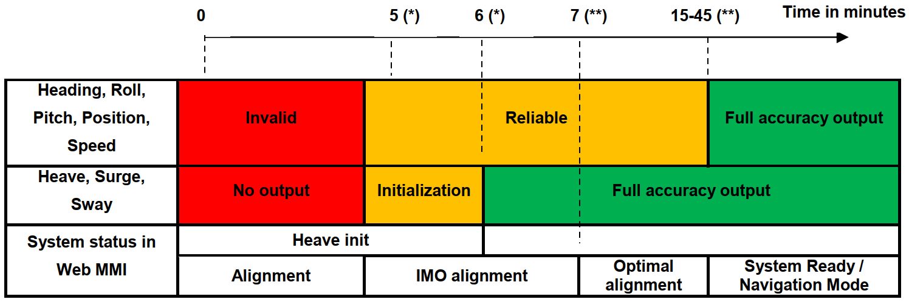
INS alignment

Slide 37
Coarse alignment
Initial data
  Knowledge of actual position (GNSS/USBL/LBL/Manually entered)
Principle
  During this phase, the INS seeks for its initial attitude and heading using a dedicated algorithm, before switching to the standard navigation algorithm
Available data
  Heading, roll and pitch are computed and sent but are not accurate (yet) and flagged invalid
  Heading is not sent/outputted during alignment phase in certain telegrams to be compliant with the NMEA standard
Can be done at quay, at sea or subsea

Slide 38
Coarse alignment: at quay
0
5
Heading, Roll, Pitch, Position, Speed | Invalid
Heave, Surge, Sway | No output
System status in Web MMI | Heave initialization
 | Alignment
Duration 5 minutes
Static position
Position input needed
  GNSS
  USBL
  Manual position

Slide 39
Coarse alignment: at sea
0
5
Heading, Roll, Pitch, Position, Speed | Invalid
Heave, Surge, Sway | No output
System status in Web MMI | Heave initialization
 | Alignment
Duration 5 minutes
With speed sensor:
  Initial position (GNSS, USBL, Manual)
  Speed input (EM log, DVL)
  No constraints
Without speed sensor:
  Initial position (GNSS, USBL, Manual)
    On DP
    Drifting with the current
    Constant speed and heading
  Ideally East to West to avoid latitude changes
Notes:
Speed sensor is needed so the algorithm knows that it’s moving since there’s no acceleration when moving at a constant speed.
Latitude changes result in impact on heading

Slide 40
Coarse alignment: subsea
0
5
Heading, Roll, Pitch, Position, Speed | Invalid
Heave, Surge, Sway | No output
System status in Web MMI | Heave initialization
 | Alignment
Duration 5 minutes
Ideally static (on DP or on seabed)
With speed sensor non-static:
  Initial position (GNSS, USBL, Manual)
  Speed input (EM log, DVL)
  No constraints
Without speed sensor but non-static:
  Initial position (GNSS, USBL, Manual)
  Constant speed and heading
  Ideally East to West to avoid latitude changes
Notes:
Speed sensor is needed so the algorithm knows that it’s moving since there’s no acceleration when moving at a constant speed.
Latitude changes result in impact on heading

Slide 41
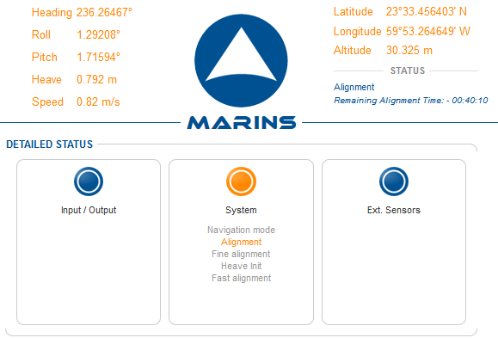

Coarse alignment
Status: Alignment
Remaining alignment time counts down from 5 minutes

Slide 42
Fine alignment
Determining where the error comes from helps to speed up the alignment
  This is dependent on the movement of the vessel
  While static, heading error and X/Y gyro bias have the same effect on the errors
  Changes in vessel heading allows these errors to be separated
SD heading<0,1°
0
5
6
10-30
Time in minutes
Heading, Roll, Pitch, Position, Speed | Invalid | Reliable
Heave, Surge, Sway | No output | Initialization
System status in Web MMI | Heave initialization
 | Alignment | Fine alignment
Notes:
15-30 min is to get rid of the white noise of the FOG’s

Slide 43
Fine alignment
The Kalman filter is activated to compute attitude, position and speed with specified accuracy.
The INS switches to the “fine alignment” phase to estimate the residual biases of accelerometers and gyroscopes to achieve optimal accuracy on attitude, position and speed
“System Ready” follows ‘fine alignment’ when Heading standard deviation below its specification
  This means that the unit is now within the inertial drift specification and is at the full performance
Residual accelerometer and gyro biases are estimated after each reboot by the Kalman filter. This to avoid storing bad values

Slide 44
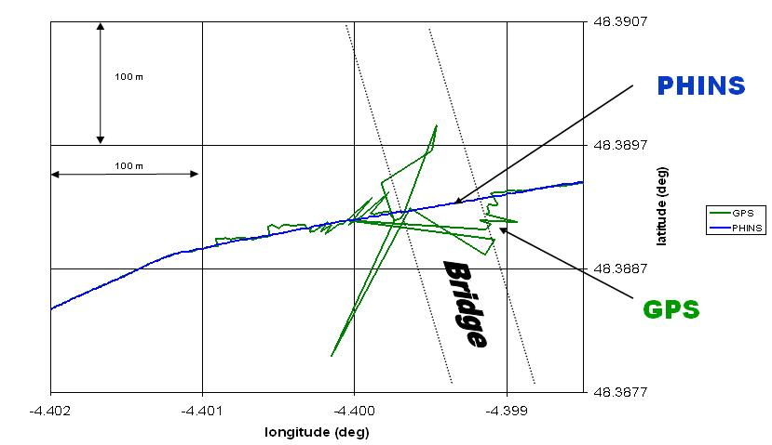
Example of GNSS outage
Phins rejects GPS and continues providing high accuracy navigation

Slide 45
Combining acoustics and INS

Slide 46
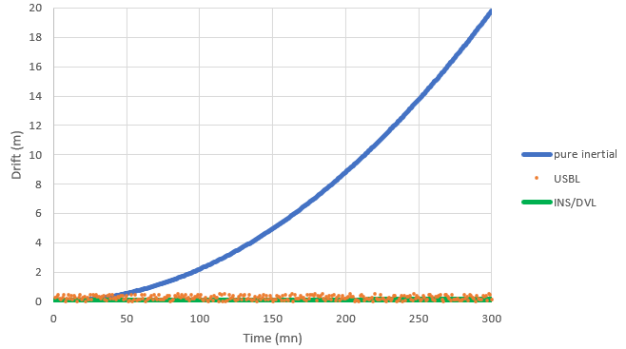
Pure inertial, INS/DVL and USBL
Order of magnitude of the drift in pure inertial: 20 m / 5 minutes

Slide 47





USBL and INS coupling
Advantages of coupling GAPS and INS:
High updates rates of the position
Position is updated even when GAPS doesn’t detect
INS rejects wrong positions
INS filters GAPS
  Higher accuracy and increased robustness

Slide 48
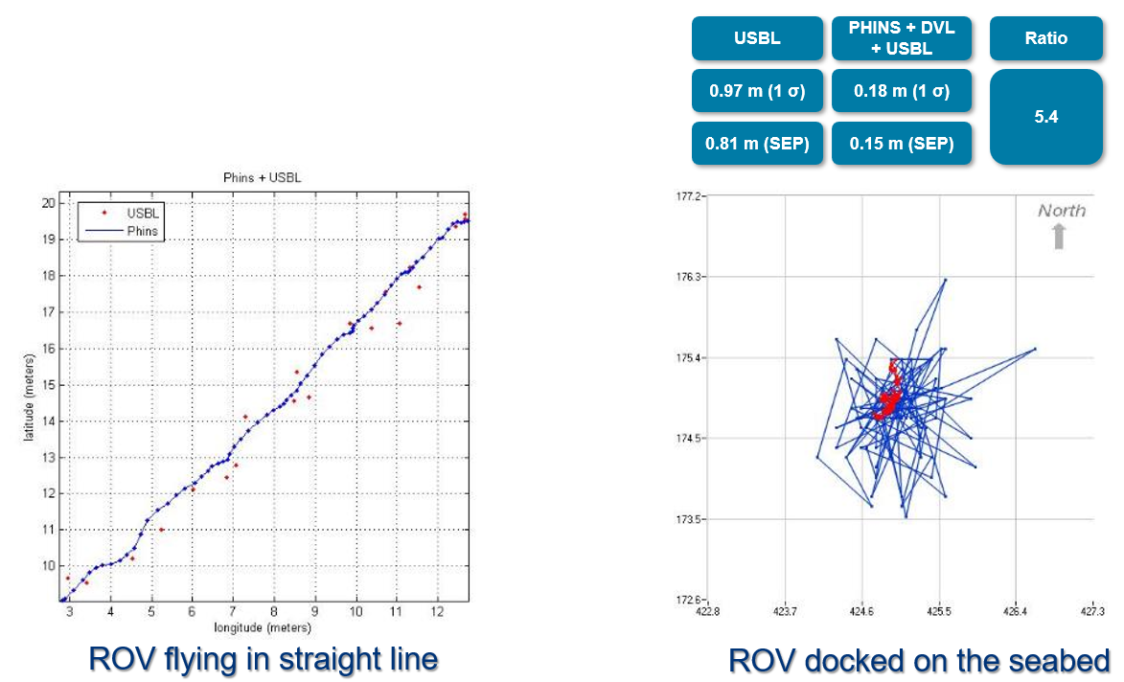
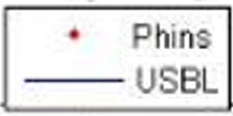
USBL and INS coupling

Slide 49
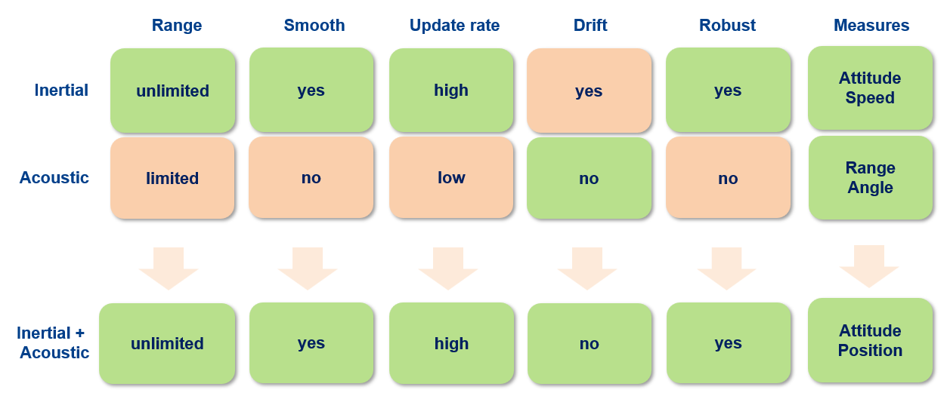
USBL and INS coupling

Slide 50
Accuracy, precision

Slide 51
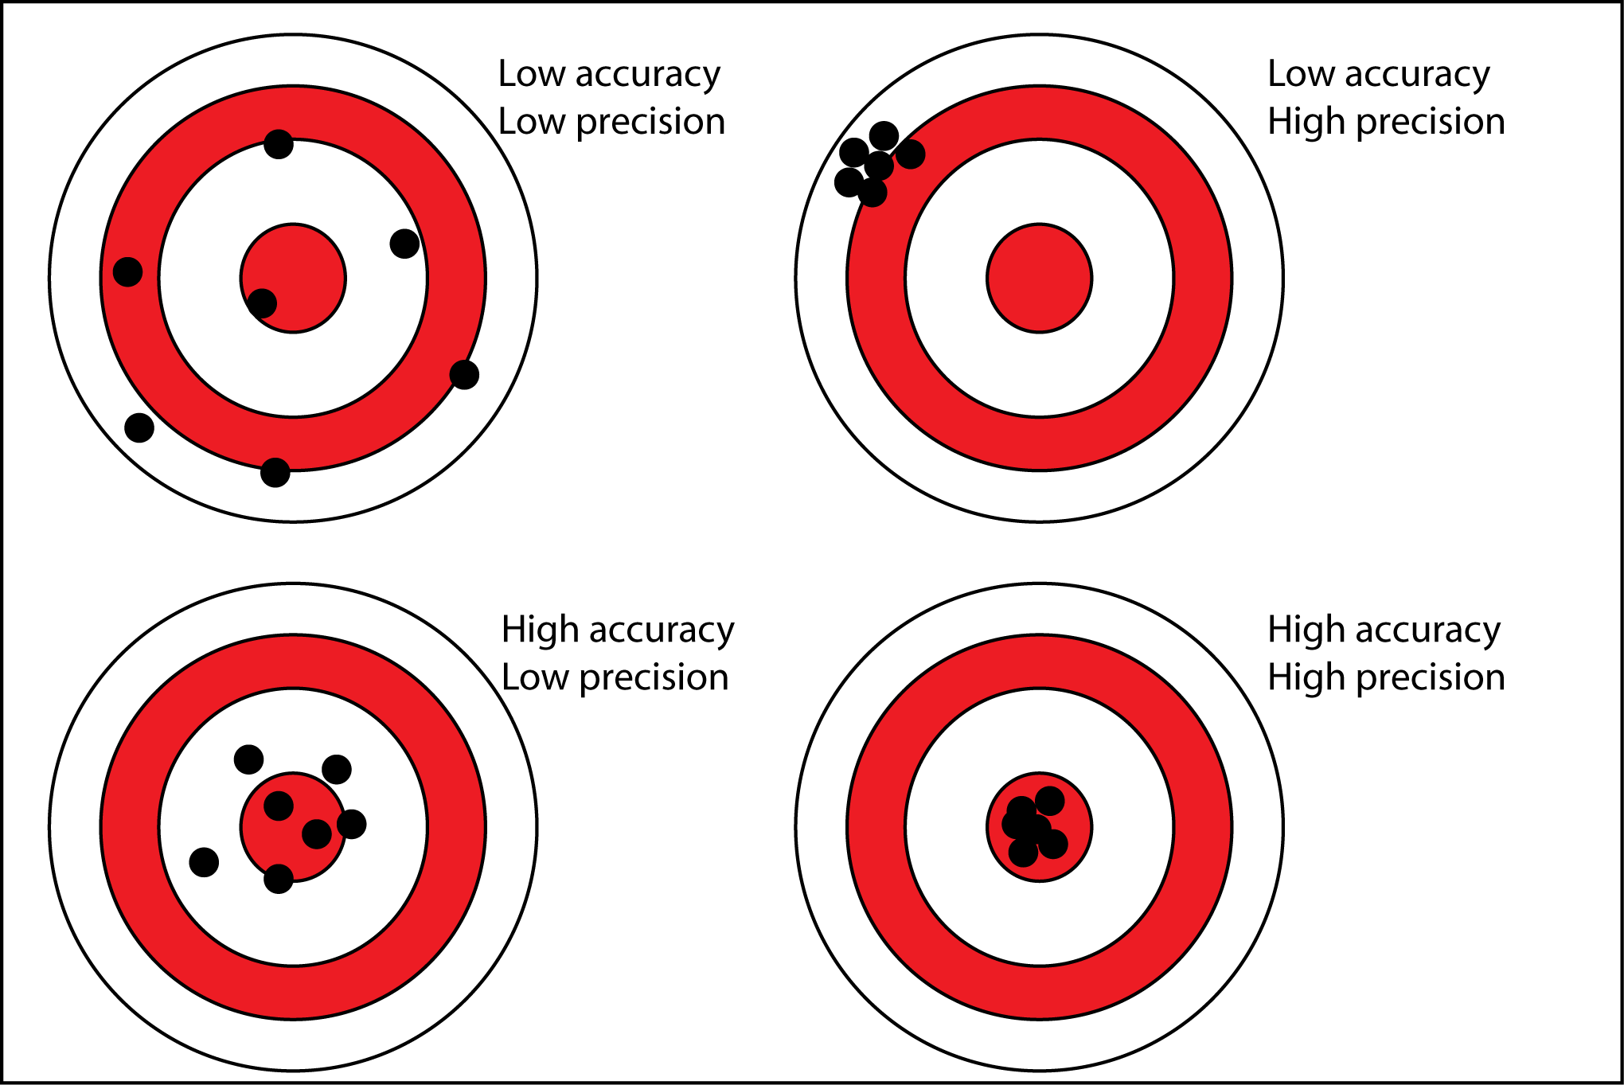
Accuracy vs. precision
There is a difference between accuracy and precision
When talking about INS and USBL, low precision means noise. And low accuracy means a bias/offset.
Source: https://www.antarcticglaciers.org/

Slide 52
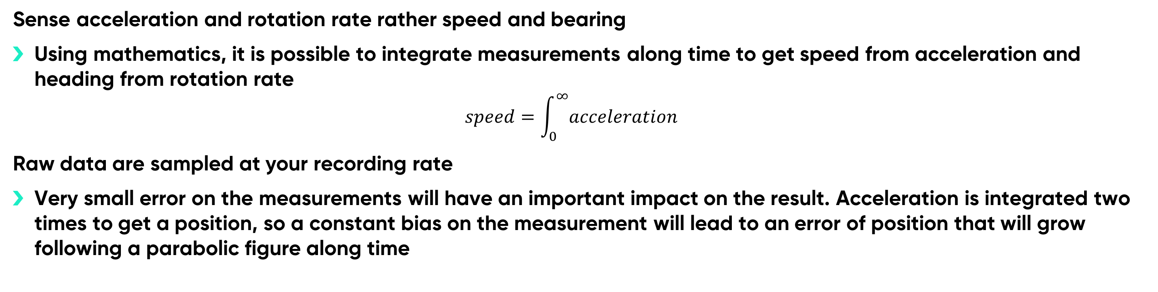
But nothing is simple!
Sense acceleration and rotation rate rather speed and bearing
Using mathematics, it is possible to integrate measurements along time to get speed from acceleration and heading from rotation rate
  $$speed=\int_{0}^{∞}{acceleration}$$
Raw data are sampled at your recording rate
Very small error on the measurements will have an important impact on the result. Acceleration is integrated two times to get a position, so a constant bias on the measurement will lead to an error of position that will grow following a parabolic figure along time
Error on acceleration
Error on speed
Error on position
time
time
time

Slide 53
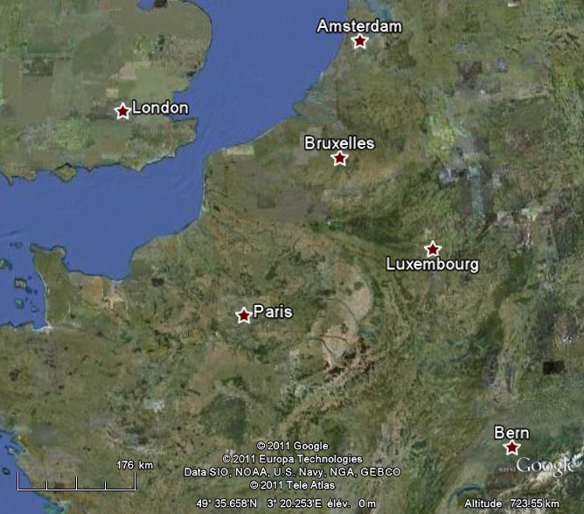
Inertial navigation basics
Speed and heading log
 | Speed (km/h) | Heading (°)
1 | 350 | 330
2 | 325 | 100
3 | 170 | 12
4 | 320 | 163
5 | 312 | 161
2
3
4
1
Navigation log
 | From | To
1 | Paris | London
2 | London | Brussel
3 | Brussel | Amsterdam
4 | Amsterdam | Luxemburg
5 | Luxemburg | Bern
5

Slide 54
The equations can be reversed
Read the log from the end to the beginning and use the opposite of the heading
2
3
Reversed speed and heading log
 | Speed (km/h) | Heading (°)
5 | 312 | 161 + 180
4 | 320 | 163 + 180
3 | 170 | 12 + 180
2 | 325 | 100 + 180
1 | 350 | 330 + 180
4
1
5

Slide 55
Basic processing (forward)

Slide 56
Reverse processing (backward)

Slide 57
Smoothing using position…
700
gps outage
600
forward
500
backward
)
m
smoothing
(
n
o
400
i
t
i
s
o
p
f
o
r
300
o
r
r
e
200
100
0
0
10
20
30
40
50
60
70
80
90
time
(
mn
)

Slide 58
Data file

Slide 59



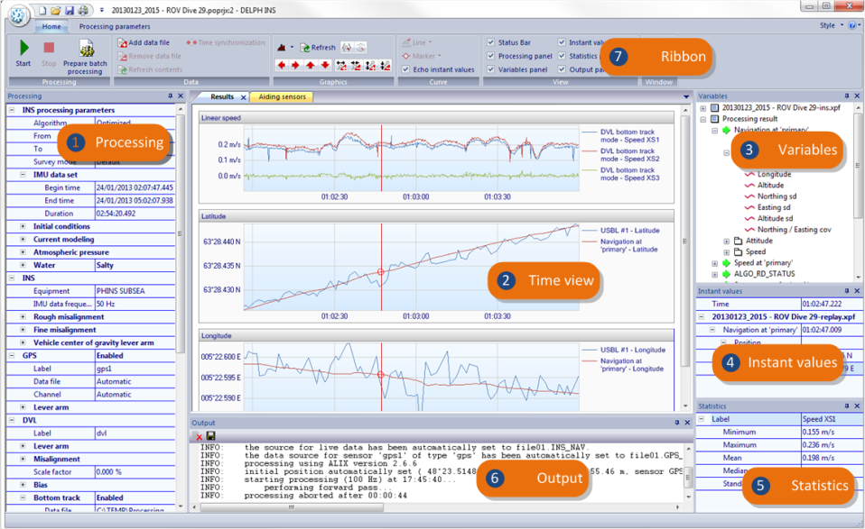
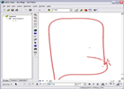
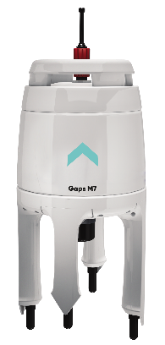




Data files accessed by Delph INS Subsea
my project
.
poprjx
config
google earth
postprocessing
input
.
xpf
my project–replay.xpf
arc view
gaps
.
nmea
external
1
.
xpf
Qinsy
DVL
external
2
.
xpf
.
pd
6
Text file for GNSS
,
notepad
Depth sensor
,
DVL
,
popudt
USBL
,
LBL
/
range
meter
,
Synchro
external3.txt
external
3
.
xpf
.
template
template
.
gtd

Slide 60
Files summary
Input files
PHINS II and PHINS III post processing data
PHINS II and PHINS III configuration files (from iXRepeater or web MMI) – configuration file is now embedded into postprocessing flux
GAPS NMEA 0183 data (.nmea)
Teledyne RD Instruments PD6 data (.pd6)
Various external file (.txt)
Native Delph INS files
Binary input and output data (.xpf)
Project – text/xml (.poprjx)
Generic text definition – text/xml (.gtd)
User defined template – text/xml (.popudt)
Output files
Google Earth (.kmz ou .kml)
ESRI Shapefile (.shp), AutoCAD (.dxf), GeoConcept (,gtx), MapInfo (.tab), Microstation DGN (.dgn), Generic Mapping Tools (.gmt), others (.geojson, .gml, .kml)
POSPac SBET (.out)
User defined format from a template (text)

Slide 61
The Xpf file format
The Xpf format (eXtended Packet File) is the native file format for Delph INS data. It is a binary format.
Data are stored into packets organized into channels:
A packet contains time stamped data (latitude, longitude, altitude)
A channel gather homogenous packets sharing the same structure (data of an aiding sensor or processing result for instance)
The header of the file is self-descriptive, it means it can be used to know the structure of the data stored into the file: the list of the channels and for each one the list of fields in each packet.
Packets into the file are linked using bidirectional pointers to allow fast data reading:
header
IMU
IMU
IMU
GPS
IMU
IMU
GPS
IMU
IMU
IMU
DVL
IMU
IMU

Slide 62

Channels of an Xpf file
A file generated from a raw POSTPROCESSING file contains the following channels:
IMU
DVL_BT
DVL_WT
EM_LOG_1, EM_LOG_2
GPS_1, GPS_2, GPS_3
DEPTH
USBL_1, USBL_2, USBL_3
LBL,
UTC,
DMI
SYNCHRO_1 à SYNCHRO_4,
INS_NAV
PLATFORM_ORIENT
SYSTEM_TIME
The structure of an Xpf file can be displayed from the MMI using the File / Properties command (expert mode must be turned on).

Slide 63
Installation

Slide 64
Package
USB Dongle
Driver automatically installed during Delph INS Subsea setup process.
Release notes
Installation program:
https://download.exail.com/delph-ins/
Software required protection key.
Driver automatically installed during Delph INS Subsea setup process.
Release notes
Installation program:
https://download.exail.com/delph-ins/

Slide 65
Licensing
Local hardware | Perpetual license* in the form of an USB dongle that can be moved to any workstation. One-year Extended Maintenance Agreement (EMA) included
Local software | Perpetual license* in the form of a software license attached to a single workstation (con be transferred in case of decommissioning). One-year Extended Maintenance Agreement (EMA) included
Network software | One year license installed on a server that can be accessed by any workstation on the network (local or remote)
Extended Maintenance Agreement | Extends the perpetual licenses to allow access to the very last releases of the software
(*) After your EMA is expired you can still use those versions, but you can not use newer version till you update your EMA

Slide 66

Licensing
The following table shows the allowed combinations of license type and subscription plans:
Our software are designed to be operated on workstation, but the use of virtual machine and remote desktop is also supported:
(*) Note that when an USB dongle is attached to a virtual machine it is no more available on the host system.
 | Perpetual | One year | One month
Local hardware | ✓
Local software | ✓ |  | ✓
Network software |  | ✓
 | Local machine | Virtual machine (*) | Remote desktop | Part number
Local hardware (iXblue) | ✓ | (✓) | (✓) | N/A
Local hardware (Exail) | ✓ | ✓ | ✓ | 00291386
Local software | ✓ |  | ✓ | 00291387
Network software | ✓ | ✓ | ✓ | 00291389

Slide 67

Software installation
Fist install the software (Follow the wizard)
Plug the USB dongle/Apply the license file

Slide 68

LICENSING
Software license
  One license per computer (with footprint)
  Time-limited
  Local license server : http://localhost:1947
Hardware dongle
  Trial/demo license
  New dongles (black, branded iXblue/Exail)
  Old dongles remain compatible

Slide 69

Warranty information
The software comes with a one-year warranty:
  Access to the new releases
  Access to the 24/7 Exail support
It is possible to extended this service by purchasing an EMA (Extended Maintenance Agreement).
The software displays a notification when the warranty is expired:

Slide 70



Updates
The last version of the software can be downloaded following this link:
https://download.exail.com/delph-ins/
By default, each week the software checks for new release:
This behaviour can be disabled from the Settings dialog box:

Slide 71



Organization of the installation folder
Executables, configuration files(.conf.xml)
User guides, Xpf file format specifications
Documentation of error messages
Documentation of import definition files (.gtd)
Documentation of export template files (.popudt)
Import definition files (.gtd) and user defined templates (.popudt) library
Import definition files (.gtd) and user defined templates (.popudt) library

Slide 72
Start software

Slide 73


Start Delph INS Subsea
Don’t open the XPF file put always your project file

Slide 74




Conversion of a raw POSTPROCESSING data file
Source file name (read only)
Target file name (.xpf)
Sort method when multiple input files
If the input data file is a POSTPROCESSING file the conversion window opens automatically.
Notifications are displayed in the Output panel of the main window.
Error messages are described in the PostproDecodeMsgDb.html guide (online documentation, Command line modules folder).
Amount of bytes to skip at the beginning of the file
Amount of bytes to process in the input file
Survey date (optional)
Specifies if the drift of the INS clock must be compensated or not (requires PPS)

Slide 75
Conversion of multiple raw POSTPROCESSING files
When recording it is possible to log the POSTPROCESSING stream in several successive files (split on a size or time basis).
Files can be sorted by:
  their content,
  their name,
  or concatenated in the order they appear in the dialog box.
Sorting of input files

Slide 76
Configuration data
Starting with INS firmware version CINT 5.xx (generation III) the configuration log of the INS is output in the POSTPROCESSING stream.
The configuration (change log) is extracted when the raw data are converted into the Xpf format. It is not necessary to provide a configuration file saved from the Web MMI or the iXRepeater software.
When decoding, two configuration files are generated :
<my data>.conf.xml Machine readable configuration log (xml)
<my data>.conf.html Human readable configuration log (html)
The second file can be displayed in any web browser to view the configuration and changes applied during the operation.
Delph INS Subsea loads the last configuration block of the configuration log.
Notes:
The INS needs approximatively 400 seconds recording to transmit the whole configuration. The recording must then be of a length greater than 2 x 400 s to ensure that a whole configuration is present in the dataset.
800 sec = 13.333 minutes

Slide 77
Adding an external file into the project
Use the command Home  Add external file to add an external file into the project (post processed GNSS for instance).
First, the user must select a data file.
Five type of files can be selected:
Text file (generic)
Delph INS data file (.xpf)
NMEA file
iXblue USBL log ($PTSAG)
DVL PD6 log (RDI)
If the file is not in the Xpf format a conversion is proposed.
after loading the file is visible in the Variables panel.

Slide 78

Main window

Slide 79


Slide 80

Ribbon
Project management (open, save, close), printing, user preferences.
Start and stop processing, external file management, plot and curve management, display of panel and time views.
Calibration function
Start and stop processing, aiding sensor management, processing parameters, output.
Visual style management
Access to the user guide, access to the « About » dialog box, license management, contact support.

Slide 81

User preferences
The user preferences dialog box can be accessed using the Settings command of the application menu.
The formatting of the data (time stamps, geographical positions, numerical values…) can be defined through this window.
When the running mode is changed (standard or expert) it is mandatory to restart the application.

Slide 82


Data time stamping principle
Data packets in a Xpf file have a relative time stamp which generally is 0.0 for the first data packet in the file.
In order to synchronize the relative time on absolute time the file includes an UTC data packet indicating the correspondence between the relative time of the file and the absolute time.
The Properties command applied on a file in the Variables panel displays the dialog box showing the time synchronization information.
Absolute time when relative time is 0.0 s
Time stamp of the first packet
Time stamp of the last packet

Slide 83



Time synchronization of data
The command Time synchronization applies to a file or a data channel in the Variables panel. It opens the File time synchronization windows used to adjust the time synchronization of a single channel in a file or of the whole file.
When this window is opened you select the Time synchronization mouse tool to adjust graphically the time offset value by sliding curves horizontally.

Slide 84
Enter data
Input of numerical data may be entered in different formats or units. Delph INS Subsea automatically converts data into the format it requires.
Geographical positions
43.162 N = 43°09.749 N = 43°09'44.935 N
43°09.749 N = 43d09.749 N = 43D09.749 N = 43 09.749 N
43°09'44.935 N = 43°09m44.935 N = 43°09M44.935 N = 43°09 44.935 N
43°09.749 N = +43°09.749 43°09.749 S = -43°09.749
Distances
10.000 m = 32.808 ft = 393.701 in
Processing time
03:32:25.732 = 12745.732 s = 12/06/2008 11:43:16.193
Display-parameter selection via Settings window in the application menu Settings
In order to edit values in hierarchical input grids use key [F2], then [Enter] to validate input or [Esc] to cancel.
In the « Processing » panel, wrong values are displayed in the red colour.

Slide 85
INS PARAMETERS

Slide 86

INS parameters
The parameters are displayed in the INS section of the Processing panel.
The equipment type and the frequency of IMU data are displayed for information purpose (read only).
The rough and fine misalignment parameters specifies the orientation of the INS with respect to the vehicle frame (XV1, XV2, XV3). Changing these parameters should be done with caution because bad values cause a sharp deterioration in the final performance of the calculation. These parameters are hidden when using old firmware version.
The lever arm of the center of gravity is used in the calculation of the heave, so there is no need to define it.

Slide 87
AIDING SENSORS

Slide 88
Aiding sensor definition
Aiding sensors can avoid very fast drift that occurs when integrating data from internal sensors (gyros and accelerometers).
Data from these sensors can “reset” the inertial data.
Supported aiding sensors are:
GNSS : provides horizontal position (latitude and longitude) and altitude
DVL : provides 3 speeds relative to the sea bed (bottom track) or relative to a water layer (water track)
DEPTH sensor : provides depth (or pressure to be converted to depth)
RANGE meter (LBL) : provides ranges to fixed beacons on the seabed
USBL : provides horizontal position (latitude and longitude) and depth
EM Log : provides forward speed relatives to the water
At the creation of the project, the sensors defined in the configuration file are added to the project.

Slide 89
Aiding sensors
Aiding sensors are displayed in the Processing panel.
Aiding sensors can be added from the contextual menu in the Processing panel or from the ribbon: Processing parameters > Add aiding sensor.
It can be used simultaneously:
2 GNSS
2 DVL (bottom track & water track)
1 DEPTH sensor
1 LBL (up to 10 beacons)
3 USBL (transponders)
2 EM Log
You can use the enable/disable feature in order to keep in the project more than the maximum accepted sensor count.

Slide 90

Adding new sensors
Aiding sensors are displayed in the Processing panel.
Aiding sensors can be added from the contextual menu in the Processing panel or from the ribbon: Processing parameters > Add aiding sensor.
It can be used simultaneously:
2 GNSS
2 DVL (bottom track & water track)
1 DEPTH sensors
1 LBL (up to 10 beacons)
3 USBL (transponders)
2 EM Log
You can use the enable/disable feature to keep in the project more than the maximum accepted sensor count.

Slide 91


Connect a sensor to a data source
For each aiding sensor it is necessary to indicate where to find the data.
This information is displayed by the Data file and Channel items in the Processing panel in each sensor section (in the bottom track and water track sections for DVL).
To connect a data source to an aiding sensor, drag and drop a channel from the Variables panel to the Data file or Channel items of the sensor.
The Clear data source command can be used to « disconnect » a data source from a sensor.

Slide 92

Connect a sensor to a data source
The mode « Automatic » for a data source specifies the software will do automatically the connexon between a sensor and a data source.
When selected the first compatible and available data source is associated to the sensor. Data sources are scanned from the main data file to the additional data files in the order of loading into the project.
When the processing starts, a notification is displayed to show which channel is associated to which sensor.

Slide 93

Sensor Label
A user defined label can be specified for each sensor.
This free text can identify the sensor, it may be useful to distinguish multiple sensors of the same type.
In the following example the label is used to distinguish the 300 KHz DVL of the 1200 KHz DVL:

Slide 94
Misalignment and lever arms

Slide 95



Sensor’s specific parameters
DVL
Bias: values to subtract from the speeds measured by the sensor on the three axis (in expert mode only).
Scale factor : correction to be applied on the measured speeds (± X %).
DEPTH sensor
Offset : constant to be added to the value measured by the sensor.
Source : indicates if the depth shall be recalculated from the pressure data (if available) or if the 'live' depth should be used.
USBL
Transponder code : Label associated to the beacon (read only, extract from the configuration file).
EM Log
Bias: value to subtract from the speeds measured by the sensor (in expert mode only).
Scale factor : correction to be applied on the measured speeds (± X %).

Slide 96



Sensor operating modes
During operations it is possible to enable, disable or force taking account from an external sensor. These changes are plotted in the "operating mode" fields of the data files:
During the processing it is possible to change this behavior by using operating mode instructions on a sensor.

Slide 97
Sensor operating modes
It is possible to combine several instructions for a same sensor. The mode associated with each statement is as follows:
Live Apply during the period the same instruction as during the operation
On The data are used unless they seem wrong
Forced The data are used even if they seem wrong
Off The data are not used
An instruction applies over a period, if the start date is missing it means 'from the beginning', if the end date is missing it means "until the end".
In the case where the sensor produces composite information (GNSS, USBL, DVL) The instruction can be reduced to one axis (one single composite data).
This function allows to "clean up" the data and do not take account of the outliers.

Slide 98
Combination of multiple instructions
When users define several rejection instructions for a same period, the « last who spoke » strategy is applied.
If one considers the following instructions:
100 – 400 : Off
300 – 900 : On
600 – 700 : Forced
The rejection instruction will evolve in the following way:
000 – 100 : Live (default)
100 – 300 : Off
300 – 600 : On
600 – 700 : Forced
700 – 900 : On
900 – xxx : Live (default)

Slide 99

Modification of standard deviations
The « user sd » instructions allow the user to change the standard deviation of a sensor on a given period.
The instruction’s mode specifies:
Raw data : the standard deviation of the data file is used
Fixed : the standard deviation provided by the user is used
Scaled : a scale factor provided by the user is applied on the standard deviation of the data file.
As for the operating modes:
several instructions of deviation may be combined,
an instruction applies over a period,
an instruction may be restricted to an axis (GNSS, USBL and DVL).

Slide 100

Minimum standard deviation instructions
The « minimum sd » instructions allows to specifies that the standard deviation of a sensor must not be inferior to a given threshold.
This feature helps to apply a « reasonable » value when the standard deviation given by the sensor is too optimistic. It allows also for example to take into account the uncertainty associated with the measurement of lever arms.
As for the operating modes:
several instructions of deviation may be combined,
an instruction applies over a period,
an instruction may be restricted to an axis (GNSS, USBL and DVL).

Slide 101

Minimum standard deviation instructions
The « minimum sd » instructions allows to specifies that the standard deviation of a sensor must not be inferior to a given threshold.
This feature helps to apply a « reasonable » value when the standard deviation given by the sensor is too optimistic. It allows also for example to take into account the uncertainty associated with the measurement of lever arms.
As for the operating modes:
several instructions of deviation may be combined,
an instruction may be restricted to an axis
an instruction applies over a period,
SD
Time

Slide 102
Maximum standard deviation instructions
You can set the threshold of the standard deviation to a maximum value.
When the SD exceeds this value it will reject the data
SD
SD
Time
Time

Slide 103
OUTPUT SETTINGS

Slide 104

Adding output
An « output » instruction is used to compute at a given location on the vehicle and using a given orientation :
The navigation data
The speeds in the vehicle frame
The heave data
A new output can be added using the command:
Add output from the contextual menu of the Processing panel.
This command is also available in the ribbon (Processing parameters tab).
It is necessary to define a unique label for the output
(12 characters a-z, A-Z, 0-9, « - » and « _ »).
Fill in the lever arm (along the vehicle frame).
Fill in the misalignment (with respect to the vehicle frame).
Do not forget to add Output rate or Synchronized output instructions.

Slide 105
Select the data to be recorded
For each output you must select which data must be stored into the result file:
Heave : heave surge and sway (4 output max).
User speed : speeds in the user defined frame (forward, left, up).
Intermediate trajectory : result of the forward and backward pass.
The output file contains the following channels associated with the output:
Navigation at ‘output-01’ in all cases
Speed at ‘output-01’ if User speed = Yes
Heave at ‘output-01’ if Heave = Yes
The Altitude reference parameter allows to indicate the vertical reference: the ellipsoid height or height on the geoid. The ellipsoid to geoid separation should be populated in the GNSS data.

Slide 106

Output rate
For each output it is possible to define instructions to set the cadences of data in the output file:
Output rate : data is output at a regular rate over the period of the instruction
Synchronized output : the data are output synchronously with the data of a channel of an input file over the period of the instruction.
The creation of these instructions is performed using the commands Add output rate and Add synchronized output from the contextual menu of the Processing panel. These commands are also available in the Processing parameters tab of the ribbon.
The regular rate output can be synchronized with UTC time or IMU data (expert mode, UTC time by default).
To connect a Synchronized output instruction with a data source, drag and drop a channel from the Variables panel to the items Data file or Channel in the Processing panel.

Slide 107


Output rate instructions
The use of several output rate instruction permits to reduce the size of the output file by changing the rate depending on the period: use a high rate on period of interest and a low rate otherwise.
If a default rate is set at 1s and another one at 5s between t = 3s et T = 17s the content of the output file is as follow:
For instance, when doing a side scan sonar survey a low output rate can be used during transits and turns (1 Hz) and a higher rate during the lines (50 Hz).

Slide 108
Synchronized output instructions
GNSS data
In addition to the cadenced output it is possible to calculate data at the moment of the validity of external data (aiding sensors or any other time series).
The computation runs at the frequency of the IMU data (typically 50 Hz or 100 Hz), then a linear interpolation is performed.
rate = 5 s
0
1
2
3
4
5
6
7
8
9
10
11
12
13
14
15
16
17
18
19
20

Slide 109
PROCESSING PARAMETERS

Slide 110
Processing parameters definition
The choice of algorithm allows to process in one pass (Basic) or 3 passes (Optimized).
It is possible to process only a period of the file using the From and To values (pay attention to the conditions of alignment at the beginning of processing).
The starting position is necessary (the most accurate possible), it can be extracted automatically from sensor data or defined by the user. In the second case the precision is optional.
The current modeling is only displayed if an EM Log or a DVL water track is used.
Atmospheric pressure parameters and density of the water parameters are only used if the depth is recalculated from the pressure provided by the depth sensor.

Slide 111
Backward navigation algorithm (Backward)
Data is chronologically integrated and filtrated by Kalman filter.
Each calculated point is the result of treatment of all previous points.
Kalman filter parameter-estimates become more precise as one gets closer to end of file.
Forward data processing
Forward data processing

Slide 112
Backward navigation algorithm (Backward)
Data are integrated anti-chronologically and filtered by Kalman filter (from end of file to beginning).
Each calculated point is the result of treatment of all points that follow.
Kalman filter parameter-estimates become more precise as one gets closer to beginning of file.
Backward data processing

Slide 113
Forward – Backward smoothing
Data going through the forward and backward processing are merged.
Each calculated point is the result of processing all points on the line.
Kalman filter parameter estimates’ precision is therefore optimal for the whole file.
Forward data processing
Backward data processing

Slide 114
Basic processing (forward)

Slide 115
Reverse processing (backward)

Slide 116
Smoothing using position…

Slide 117
Smoothing using position and speed…

Slide 118
Vehicle model
The vehicle model instruction allows the user to inform the processing that the INS is not moving (zero velocity) during a period. This mechanism is equivalent to a fake speed sensor providing 0 speed.
Multiple instructions can be combined.
The accepted mode values for ZUPT instructions can be:
Live : reproduce the same behaviour as during the operation
None : disable the ZUPT feature
10 m/s : 0 m/s speed input with 10 m/s standard deviation
0,1 m/s : 0 m/s speed input with 0.1 m/s standard deviation
0,01 m/s auto : detects system movements and when no rotation larger than 10 °/h is detected, it enables a null speed entry with 0.01 m/s standard deviation
No rotation : detects movements and when no rotation larger than 10 °/h is detected, it enables a null speed entry with 0.01 m/s standard deviation and a null rotation of 10 °/h standard deviation. This mode is for factory tests. Do not use
Position: indicates to the algorithm that the INS is static. Contrary to a standard vehicle model where the speed is around 0, meaning that the system can drift drifting slowly, when the position mode is used, the system cannot drift.
In underwater applications this feature must be used in a reasoned manner because it is rare that a system be completely immobile.
The use of the live mode is not recommended since the POSTPROCESSING protocol does not include enough information to do an exact replay of the instruction set by the user during the operation.

Slide 119
Altitude mode instructions
These instructions specifies how the algorithm must be aided to limit the vertical drift.
Multiple instructions can be combined.
Five different modes are available:
Live
Stabilized
GNSS
Depth
Hydro
USBL
In underwater applications we strongly recommend that you use the Depth mode. If there is no more information from the depth sensor, data provided by the USBL are used after 10 s.

Slide 120

Current modelling
The current modelling item is hidden if no DVL nor EM log is used.
When absolute positioning (GNSS, USBL) information, distance to a fixed beacon (RANGE meter) or speed relative to the bottom (DVL bottom track) are available the algorithm estimates the current. Then when only relative speeds are available the algorithm update the current value using amplitude, time and distance information.
If the values are not filled by the user, default values are used

Slide 121

Compute depth from pressure
When the depth sensor provides information of pressure the calculation of depth can be achieved by the algorithm, taking into account the following parameters:
Atmospheric pressure log (if available)
Default atmospheric pressure (1013.25 hPa if not defined) if no log is available
Type of water (fresh or salty)
Density of water (999.972 kg/m3 if not defined)
When Pressure and depth are recorded the real-time is using the give Depth, Delph INS Subsea is using by default the pressure

Slide 122
DATA BROWSING

Slide 123

Data files and data file contents
The Variables panel displays the data files of the project (Xpf files) as well as the contents of these files: the data channels and the logical structure of these channels.
Only channels that actually contain data are displayed, the empty channels are hidden.
The view is updated in real time, if a file is created or is deleted the view automatically reflects the change.
Use the Refresh contents command to update the state of a file if this one seems not correct.

Slide 124



Properties of a file
The properties of a file allows to view the general information on this file:
Name and location.
Size, creation and modification date.
Time stamp of the origin of the relative time (when available).
Time period of the data present in the file.
A label can be used to simplify the view in the application.

Slide 125

File structure description
In the expert mode, the file properties dialog box contains a tab describing the logical structure of the file.
The name of each channel appears in its raw form.
The fields of each channel are also presented in their raw form.
This information may be useful when writing user defined templates to export data in the text format.

Slide 126

Graphical display of data
The graphical display of data is carried out by drag and drop a measure of the Variables panel to the central area of the main window.
Click on the variable to display then without releasing the mouse button move the cursor to the central area of the window, then release the button.
During the movement of the cursor the insertion point is represented visually in the central area (insertion between two graphs or inserting into an existing graph).

Slide 127

Organization of graphics
Graphics as well as their contents are stored in the project and re-opened at the next session.
It is possible to resize the graphics using the mouse by placing the cursor over the lower edge of the graph.
Legend maybe displayed at right, left or hidden using the Graph legends command available in the context menu.
The deletion of the active chart (the one with the title bar is blue) is done through the Remove command of the contextual menu.

Slide 128

Management of curves
To change drawing attributes
To select a curve
It is possible to change the drawing attributes of a curve (color, thickness, markers...) from the pop-up menu toolbar or from the ribbon commands.
To delete a curve

Slide 129


Scale change
The Vertical scale and Horizontal scale contextual menu commands allows to change the scales of a chart to precisely adjust the display over the period to visualize.
These settings are stored in the project file.

Slide 130

Plan View
Plan view can display one or several 2D geographical views by using the drag and drop function from the Variables panel to the Plan view.
Notes:
1, These are the coordinates of the data and the distance traveled displayed when the mouse moves on the 2D geographical view in the Plan view.
Right-click on this view to get access to other options like to get projected position, to copy to clipboard, to adjust time scale, to use automatic UTM projection, to view distance traveled and to view time cursor position.
2, This is the name of the data displayed in the Plan manager panel. You can add several channels and then choose different means of display in the Plan manager window. You can display the channel either in normal mode or in OpenStreetMap with the real map under the trajectory .
Right-click on this panel to remove the data or to bring front/back or send front/back in case of several data.
3, This is the scale of the 2D geographical view.

Slide 131

Plan View

Slide 132
Management of graphics using the keyboard

Slide 133

Multiple pages of graphics
Graphics can be organized into multiple pages.
The title of each page can be changed from the ribbon.
It is possible to split multiple pages on the screen.

Slide 134

Decimation of the data in a graphic
When the scale factor is very low regarding the data rate a decimation is performed before display.
In this case for each horizontal pixel of the screen are collected the minimum value, maximum value and an indicative value (middle time value).
This provides visually the signal envelope (drawn in pastel color) and an indicative value (drawn in more vivid color).
envelope
indicative value

Slide 135

Display of instantaneous values
To inspect the value of a given variable at a given time drag and drop this variable from the Variables panel to the Instant values panel.
When the cursor moves over the graphics the value of variables at the time pointed by the cursor (red line in the graphics area) is displayed into the Instant values panel.
A red circle highlights the data on the chart if the Echo instant value command is enabled.
It is possible to modify the timestamp of the cursor by directly modifying the Time value in the Instant Values panel.

Slide 136

Printing and print preview
The graphs appearing in the main display area can be printed on any Windows standard printer.
The settings of the printer can be changed using the command Print Setup…
Using the command Print Preview, a preview is displayed.
To print, use the Print command.
These commands are available in the application menu.
Multiple pages are printed if the graphs can not fit on a single page.

Slide 137


Copy graph drawing to clipboard
Using the command Copy graph to the clipboard from the contextual menu you can place the drawing of the selected graph into the clipboard and then paste it into any standard Windows application like Microsoft Word or other.
The graph is copied as a vector drawing, so it is possible to resize it into the destination application without any loss of resolution.

Slide 138

Copy graph data to clipboard
The command Copy data to clipboard from the contextual menu allows to place the current curve data in the Clipboard of the system to allow the transfer into any Windows application like Microsoft Excel or other.
For each time step the following data are available:
  Value at the time stamp (or the closest value)
  Number of data displayed in that pixel
  Minimum value of the data in the pixel
  Maximum value of the data in the pixel
The last three columns provides the envelope of the
signal when the data are sub sampled on the screen.

Slide 139


Statistics calculation
Use the Statistics tool to collect data from the active curve on a given period selected using the mouse (and then adjusted in the Compute statistics window).
Statistical data are displayed in the Statistics panel and are stored in the project:
  Minimum value
  Maximum value
  Mean value
  Median value
  Standard deviation
Use the Refresh command from the contextual menu to restart the calculation if the data have changed.

Slide 140


Details of a statistic
The detail of a statistic can be displayed in a window. There is the information used to calculate the data (file, channel, period), the statistics on the whole population as well as statistics on the population reduced to 50% x 3 (to remove the outliers).
The second tab of the window shows the distribution of data.

Slide 141

Trajectory separation calculation
This function allows to calculate the separation between two trajectories based on elapsed time, i.e. the distance point to point over the time.
The result of the calculation produces:
The distances in the geographic coordinate system (East, North, vertical)
The distance in the horizontal plane (2D)
The 3D distance
The data are saved in an Xpf file whose name is proposed automatically on the basis of the name of the project file (My project-diff-01.xpf).

Slide 142


To compute the trajectory separation
The tool is activated by making a drag and drop from one channel to another in the Variables Panel. It is also possible to use the Compute trajectory separation command from the contextual menu of this panel.
The files to compare are identified as Left and Right.
The Join parameter indicates what is the source of synchronization: the file right, the left file, all points (Any), only the synchronous points in both files (Both). A linear interpolation is performed if necessary.
The generated file is added to the project.

Slide 143
PROCESSING

Slide 144


Starting the processing
Use the Start button of the ribbon to launch the processing.
The processing can only be started if all the parameters are correct, incorrect parameters appear in red in the Processing panel.
The project must be saved before starting the processing.
If the parameters have changed since the last processing the user is prompted to change the name of the project or overwrite the previous result:
The process runs as a background task. The progress is displayed in the right bottom of the main window.

Slide 145

End of processing
It is possible to interrupt the processing at any time using the Stop button in the ribbon.
Processing automatically stops when the end of the data file or the end of the processing period is reached.

Slide 146

Result files
The name of the result file is based on the name of the project file to which is added the suffix -replay and the suffixes -fw or -bw for the results of the intermediate calculation passes (algorithm Optimized).

Slide 147
Report

Slide 148


QA QC report
Quick overview data set
Report of recorded and used data

Slide 149

INS config
Quick overview data set
Report of recorded and used data
Blue = new / changed info
Black = same as before

Slide 150
DATA EXPORT

Slide 151


General principle
To export data use the contextual menu of the Variables panel, select the file or the channel of the file containing the data to be exported.
Four export formats are available:
  Google Earth
  Geographic (GIS)
  SBET
  User defined using a template

Slide 152


Common parameters
The dialog box to define export parameters is similar what ever is the selected format.
The field Source specifies the main file containing data to be exported.
The field Target specifies the name of the destination file.
The fields From and To can be used to restrict the export to a given period. These fields are optional (if empty: from the beginning and / or until the end of the source file).
Click on the Start button to perform the export.
At the end of processing, the target file is opened with the application associated to the extension of the target file when the Open the target file at the end of the process control is checked. When the control Close window at the end of the process is checked the window is closed at the end.

Slide 153

Google Earth export
The selected channel must include navigation data (latitude, longitude, altitude/depth consecutive fields).
When multiple geographic data are available the item Geographic field is used to select the geographic fields to be used.
The target file is compressed by default (.kmz), the item Compress output can be turned off and generate a plain text file (.kml).
Placemarks in the target file are time stamped. The item Time reference let you choose if the time reference is from the file or the project (is this case user define time offset are applied).
The Points section permits to specifies the drawing attributes for points. It is possible to set a colour depending on the standard deviation (green, orange, red), two thresholds must be defined.
The Lines section permits to specifies the drawing attributes for the lines plot between each points.
The Heights section permits to specifies 3D parameters, you can define an offset and a vertical scale factor.
The Decimation section can be used to reduce the number of points in the target file.

Slide 154

Google Earth export

Slide 155

GIS export
The item Format lets you select the format of the output file.
The selected channel must include navigation data (latitude, longitude, altitude/depth consecutive fields).
When multiple geographic data are available the item Geographic field is used to select the geographic fields to be used.
Features in the target file are time stamped. The item Time reference let you choose if the time reference is from the file or the project (is this case user define time offset are applied).
The Decimation section can be used to reduce the number of points in the target file.
Notes:
GIS: Geographic Information Systems

Slide 156

SBET export
This export produces output in the POSPac SBET format which is supported by several software as Qinsy and HYPACK.
The selected channel must include navigation data (latitude, longitude, altitude/depth consecutive fields).
You can output time as week seconds or day seconds using the Timestamping reference item.
You can decide to output an additional file containing accuracy data. The name of the file is based on the name of the target file with the –accuracy suffix.
The Decimation section can be used to reduce the number of points in the target file.

Slide 157

Export using a User Defined Template
This export permits to build customized output format using a template (user defined template file – extension .popudt).
The template file must be selected first. Several templates are provided in the installation folder (C:\Program Files (x86)\Exail\Delph INS Subsea\Templates by default).
The template file is a text/xml file, you can use Notepad++ to authoring such files.
Depending on the content of the template file the user may be prompted for additional channel and values.

Slide 158

Customize User Defined Template
Last customized channel is the defines the rate

Slide 159
Calibration function

Slide 160

DVL Calibration
DVL calibration:
Estimation of mechanical misalignments
Estimation of scale factor
Requirements
Same as Realtime calibration,

Slide 161

DVL calibration

Slide 162

DVL calibration

Slide 163

DVL calibration
The standard deviation is displayed in green (good) when it is lower than the valid SD
The standard deviation is displayed in orange (medium) when it is lower than twice the valid SD
The standard deviation is displayed in red (not good) when it is greater than twice the valid SD

Slide 164
GNSS Lever Arm ESTIMATION
No direct measurement but an algorithmic estimation of the relative location
Movement + rotation needed to estimate the GNSS lever arm
Assumptions:
  GNSS SD is correct
  Lever arm is not changing (no bending)
  INS is in a good condition

Slide 165


Report

Slide 166
User Defined Template

Slide 167

Customize User Defined Template
Historically people afraid
Need to know the command or dig in documentation to get the commands

Slide 168

Customize User Defined Template

Slide 169

Customize User Defined Template
Most changes and possibilities are possible (output data multiplier divisor offset change notation datum transformation…..
Some very special items are not yes easily possible (When their data in X output Y, extra text output

Slide 170
Tuning SD
Depth Sensor

Slide 171
INS Z or depth sensor
Depth sensor has waves
INS can drift

Slide 172
INS
Blue = Depth sensor
Red = INS

Slide 173
INS + DVL
Add a DVL (Green)
Notes:
Depth SD 1 meter

Slide 174
Depth sensor to 0,3

Slide 175
Optimized algo

Slide 176
Result
RED = Depth sensor
Green = INS
Optimized + tuned depth SD

Slide 177
Result
Always a trade off
Lower Depth SD = move waves in data
Higer Depth SD = more slow drift in data

Slide 178
Quick data set check

Slide 179
Quick data set check
Decoding of the post-processing file
  Warnings
  Missing frames
  Note the byte offset in the error messages to skip corrupted part of the raw file
Alignment
  5 minutes still at the beginning of the file
  Plot the INS real-time navigation to find flat latitude and longitude at the beginning of the file
  Check the navigation mode is reached before the operational part of the survey
Operating modes of the aiding sensors
  No forced (always true) operating mode by default. If the forced instruction is used it must be understood.
Sensor config
  Lever arm configured
  DVL calibration parameters
Data quality
  SD received
  Is the SD correct
  Noise on input sensor

Slide 180


BATCH PROCESSING
DELPH INS
Advanced Subsea
INS post processing software

Slide 181
Perform actions from batch files
The main tasks available in the man-machine interface can be performed from command line.
Commands are organized into four categories:
  Import, these functions allow to convert raw files in the DELPH INS native format (.xpf file).
  Processing, this function implements the inertial processing, it works from a parameters file written in XML.
  Export, these functions allow to convert native DELPH INS data (.xpf file) in other formats to transfer data into third-party applications.
  Tools, this feature is the trajectory separation calculation.
"Batch" processing allows:
  To process a batch of files with the same parameters without human intervention.
  To process several times the same file with different settings, always without human intervention.

Slide 182
Command line module reference
Importation
GenericText2Xpf | Conversion of tab separated text file into Xpf file
Nmea2Xpf | Conversion of NMEA0183 text file into Xpf file
PD6Rdi2Xpf | Conversion of PD6 (Teledyne RD Instruments) text file into Xpf file
PostproDecode | Conversion of raw POSTPROCESSING file into Xpf file
Exportation
UdtExporter | Export of Xpf file into a user defined text file
Xpf2Gis | Export of Xpf file into well-known GIS (Geographic Information System) format
Xpf2Kml | Export of Xpf file into Google Earth file (.kml ou .kmz)
Xpf2Sbet | Export of Xpf file into SBET file (APPLANIX file format)
Traitement
PostproIns | Inertial post processing
Outils
XpfNavDiff | Trajectory separation calculation

Slide 183


Slide 184
Preparing a processing parameters file from DELPH INS
The Prepare batch processing command allows to create a processing parameters file from the active DELPH INS project.
Once the file created it is possible to modify it prior to start processing using a command shell by calling the PostproIns module.
  PostproIns myCommands.xml
It is possible to change the name of the data files to apply the same settings to multiple sets of different files.
  PostproIns myCommands.xml /file file01 data02.xpf /file output data02-replay.xpf

Slide 185

Visualization of a processing result
It is possible to create a DELPH INS project from a batch parameters file to view the result of the processing.
This action is performed using the New from xml parameters file command (application menu). You then have the option to change the name of files that were used when processing:

Slide 186
Command prompt tips & tricks
Addition of the installation folder of DELPH INS in the executable search path
  set PATH=%PATH%; "C:\Program Files (x86)\iXBlue\DELPH INS\“
Loop on to a series of values
  for /l %%x in (1,1,10) do (
  echo %%x.xml
  PostproIns %%x-parameters.xml /file output %%x-replay.xpf
  UdtExporter /t UTM_31.popudt output %%x-replay.xpf %%x-replay.txt
  )
Loop on to a series of files
  for %%x in (*-parameters.xml) do (
  PostproIns %%x /file output %%~nx-replay.xpf
  )

